Slide 1
BA472 Course Project:
An Analysis of Disney’s Performance and Long-Term Strategy
Yilan Ruan Boston University Class of 2024

Slide 2

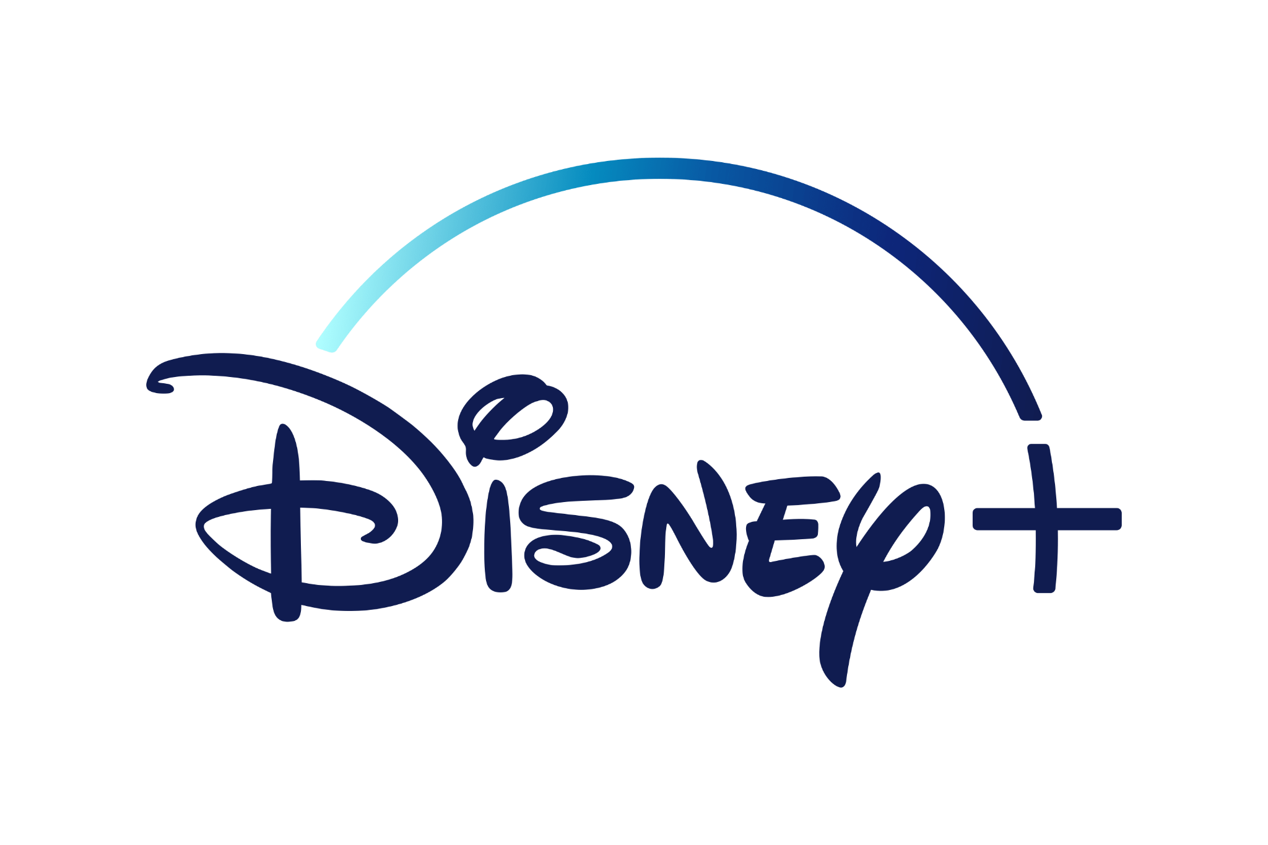
Walt Disney Studios Premises For Conducting Experiments
Goal
Experimental Methods deployed
Revenue Streams
Benefit for Disney
Analyze areas in which Disney can improve its top-line success
Cost savings in which segment to target specific movies
Better Understand factors that drive movie success
Hypothesis Testing
Analysis of Variance
Heterogeneity
Box office Income from Movie Releases
Better Understand factors that directly causes an increase subscriber count
Linear Regression
Casual Relationship using DoWhy
Subscription Service

Slide 3



Data Description
We had a total of 3 datasets for our analysis
1
2
3
Disney Movies Total Gross
Disney+
Survey Data
Observations
513
Variables
6
Observations
933
Variables
6
Observations
459
Variables
5
KPI: [Total Adjusted Gross Adjusted for Inflation]
Factors: [Genre]
KPI: [Subscriber Count]
Factors: [Rec System], [Income], [Age]
KPI: [Preference]
Factors: [Age]
Notes:
To be completed

Slide 4
Research Question 1 + Hypothesis Testing
Does Disney’s movies from 1933 to 2016 gross more than $302,872,154?
Assumptions to be Met
Hypothesis Testing
Results and Importance
We need independent samples
Null Hypothesis: The average Disney movie from 1937 to 2016 grossed less than or equal to $302,872,154.
Failure to Reject the Null
Indicates that Disney movies from 1933-2106 is not equal to $302mil.
We ran the Chi-Squared Test on [inflated_adjusted_gross] and received a p-value of 1. This means we reject the null hypothesis and the samples are independent.
We need an adequate sample size
Alternative Hypothesis: The average Disney movie from 1937 to 2016 grossed more than $302,872,154.
Significance of
$302,872,154
Mean of all Disney movies 2016 onwards.
Using .describe(), we discovered the count for this dataset is 533 which is above the requirement of 30 to apply the CLM.
Effect Size
Result: with a p-value of 1 which is > alpha value of 0.05, we fail to reject the null hypothesis
Disney’s recent movies are grossing more than before which means the production team is heading in the right direction.
For a small/medium effect size of .2 and .5, we needed 199/34 samples and since our data had 533, we have collected sufficient data.
Company Implications

Slide 5

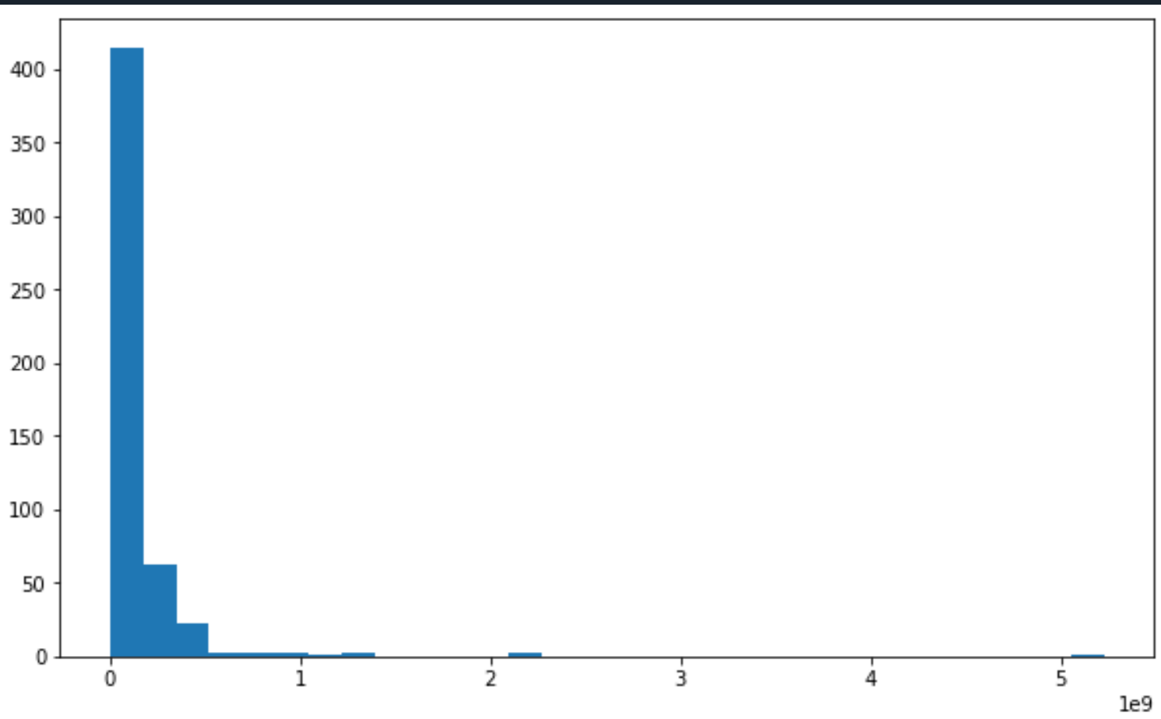
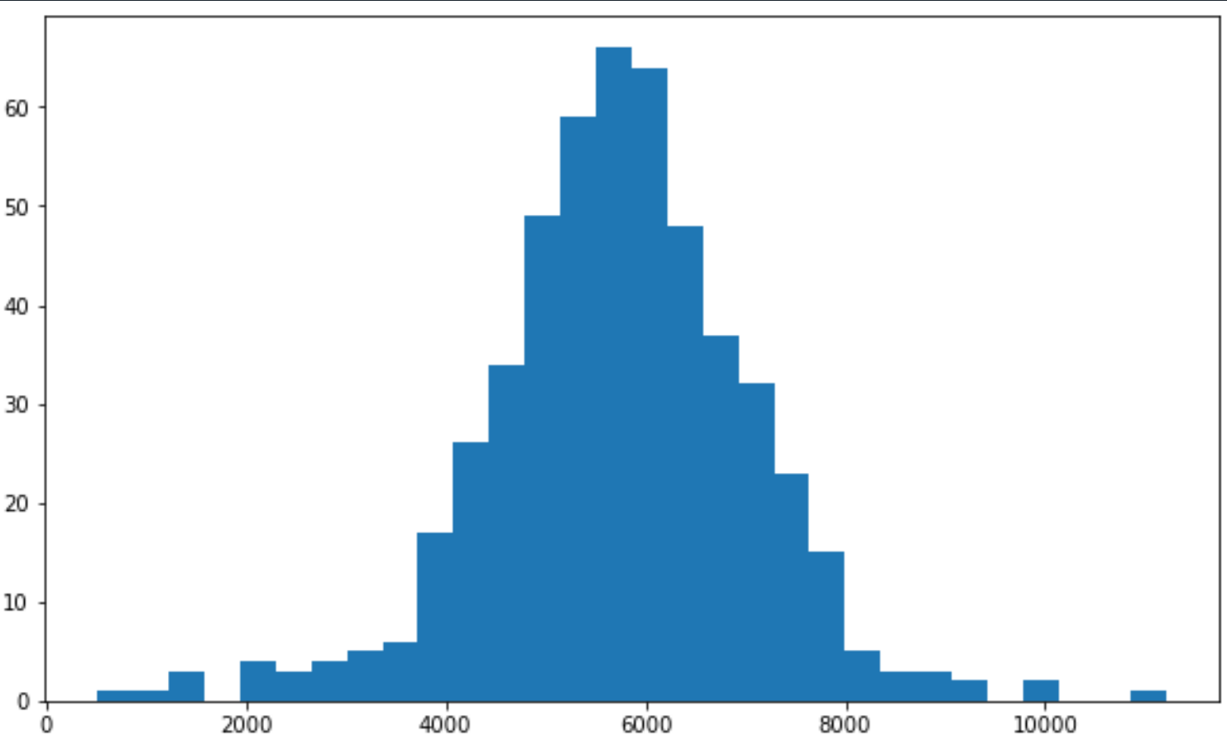
Research Question 1 + Hypothesis Testing
Research Question 2 + Anova and Tukey
Research Question 2: Does a change in genre lead to a higher box office gross in Disney Movies?
Data Clean-Up
Transforming Skewed Data
Before beginning experiment, we needed to check to see if the dataset meets the three assumptions: normal distribution, independent samples, and equal variances.
Unequal Variances
Independent Samples
Normally Distributed
Impact
- We used the bartlett test which produced a p-value of 0.01.
-We safely rejected the null indicating that there exists at least one variance that is different from the rest.
- We ran the Chi-Squared Test on[inflated_adjusted_gross] and received a p-value of 1. This means we reject the null hypothesis and the samples are independent.
- The Shapiro Wilk test gave us a p-value less than 0.05 meaning we can reject the null that the data is normalized. This means that we had to normalize our data
[Total Adjusted Gross Adjusted for Inflation]
Before Transformation
[Total Adjusted Gross Adjusted for Inflation]
After Transformation
We decided to use the log method and then cubed each term, after the log transformation.
Skewness before: 11.205 Skewness After: -0.247
Notes:
https://www.intechnic.com/blog/100-ux-statistics-every-user-experience-professional-needs-to-know/

Slide 6
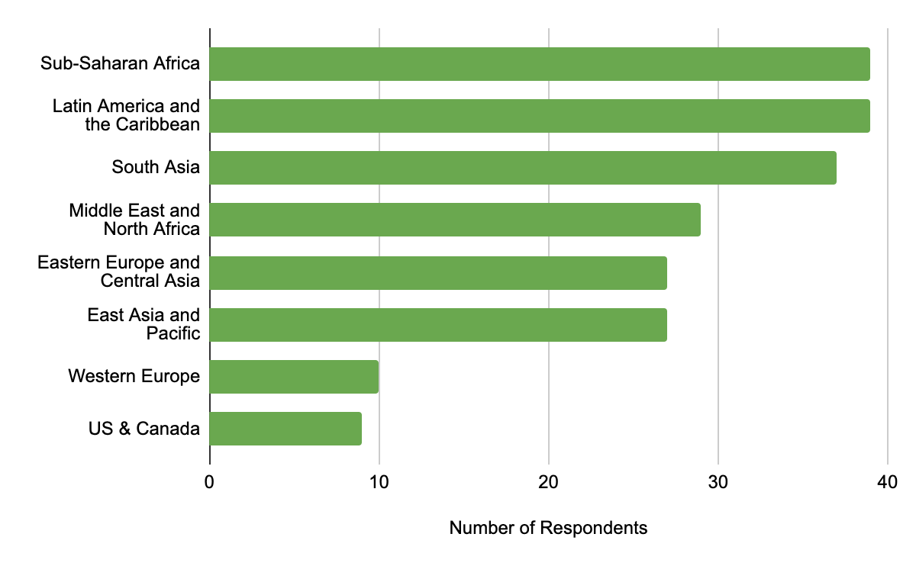
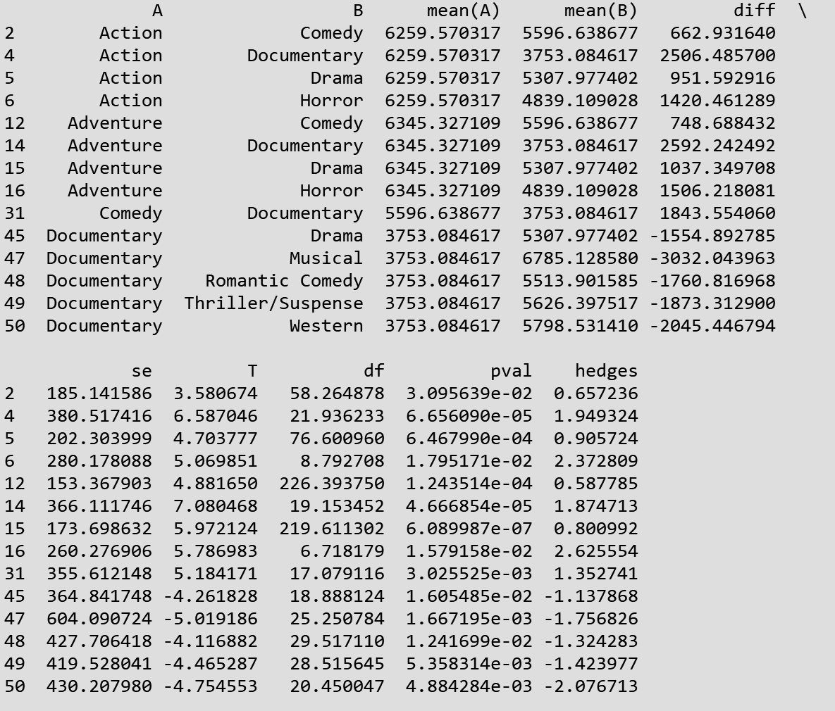
Research Question 2 + Anova and Tukey
Running a Welch Anova and a Games Howell Post- Hoc Tukey test
There exists a difference between adjusted inflation gross as the genre changes
The six most successful genres are Action, Adventure, Western, Musical, Romantic Comedy, Thriller/Suspense
Welch Anova takes 4 inputs:
Experimental Method
Dependent Variable (adjusted inflation gross)
Queries (Sorted through Genre)
Cubed Values (Transformed Data)
Dataframe (Disney Movies Total Gross)
(Action and Adventure), (Action, Musical), ( Action, Romantic Comedy), (Action, Thriller/Suspense), (Action, Western), (Adventure, Musical), (Adventure, Romantic Comedy), (Adventure, Thriller/Suspense), and (Adventure, Western).
Null Hypothesis: There is exists no difference in the adjusted gross inflation as the genre changes
Alternative Hypothesis: There exists a difference in the average inflation_adjusted_gross as the genre changes.
P-Value: 0.000035 <Alpha Value of 0.05
Results
Potential Explanations for Why these Genres are successful
Disney may have invested heavily in these specific six genres.
Notes:
This test accounts for instances when the data variances and the sample sizes are unequal between groups.

Slide 7


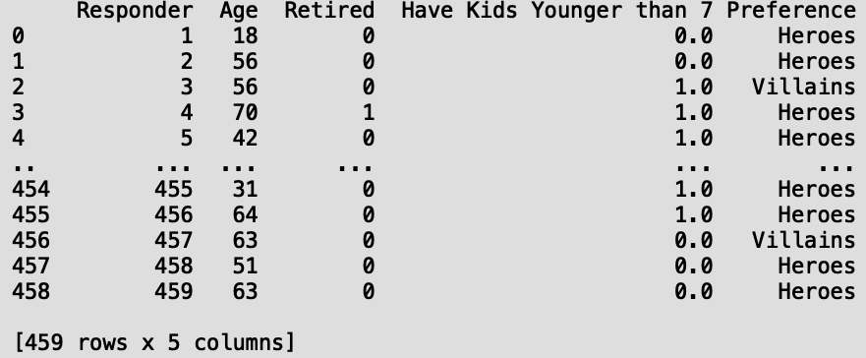
Research Question 3 + Heterogeneity Testing
Are viewers who are younger than 44 years old and 44 years old and older feel differently about the existence of heroes and villains in Disney movies?
Dataset: Survey Data about people’s preferences for Villains/Heroes
Expected Cell Count
 | Villains | Heroes
Age < 44 | 93 | 85
Age >=44 | 146 | 128
2.
The p-value of this heterogeneity test is 0.260, as shown in Figure 4. It is greater than the significance level of 0.1.
CANNOT RESULT THE NULL
1.
Null Hypothesis: There exists a difference in preference for heroes/villains within the two different age groups
Alternative: There is no preference for heroes and villains in both age groups.
We cannot conclude that viewers younger than 44 years old and viewers who are 44 years old and older feel differently about the existence of heroes and villains in Disney movies.
Notes:
Bring out possibility of coupon websites
Sources:
https://content-na1.emarketer.com/amazon-advertising-2018
http://scholar.google.com/scholar_url?url=https://www.bedicon.org/wp-content/uploads/2018/01/marketing_topic7_source1.pdf&hl=en&sa=X&scisig=AAGBfm1n3Vf-MFiplY4YB6W5ikuRvf4U1Q&nossl=1&oi=scholarr
http://whartonmagazine.com/blogs/how-amazon-targets-millennial-parents/#sthash.pojRln9A.MDZXvnLO.dpbs
https://www.lexingtonlaw.com/blog/credit-cards/millennial-spending-habits.html
https://www.iab.com/wp-content/uploads/2016/05/ShareThrough_IAB-NewFronts-Lunch-Presentation-2016.pdf

Slide 8
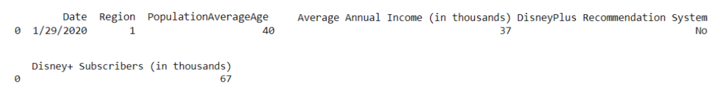
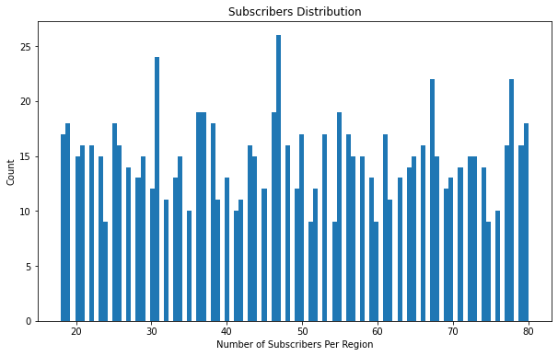
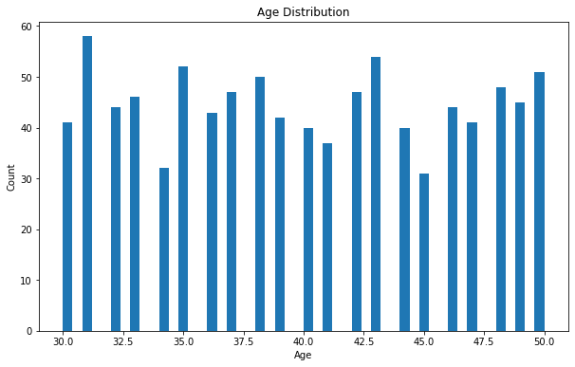

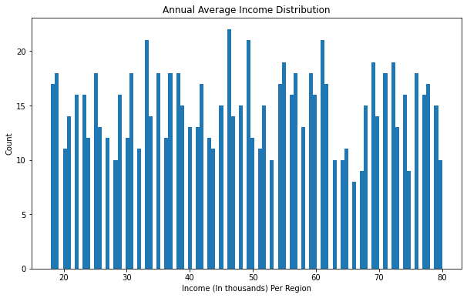
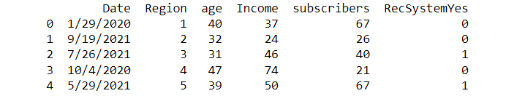
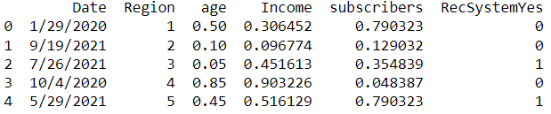
Research Question 4 Linear Regressions and ATE
Meeting Regression Assumptions: Normalization and creating a dummy variable
Disney+ Data Cleanup
Their Investment in Sustainable Agriculture is a new area of interest
Goals of BirdScape
Notes:
We collaborate with conservation teams on projects that engage the participation of a range of investors and generate a consistent source of capital to support the completion of these projects.

Slide 9
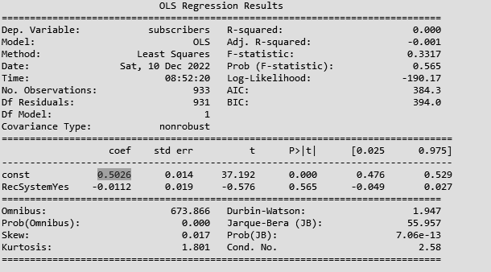
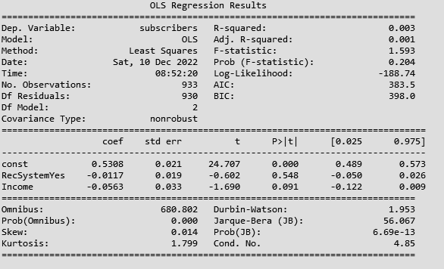
Research Question 4 Linear Regressions and ATE
Running regressions to estimate the relationship between the recommendation system and subscriber count
Regression 1 : Recommendation System on the Number of Subscribers Regression
Regression 1: Disney+ Subscribers (in thousands) = 0.5026 - 0.0112 *DisneyPlus Recommendation System_Yes
Const: 0.5026 or 49,160 subscribers
ATE: -0.0112 or -17,305 subscribers
STD Error: 0.019
P-Value: 000
[
Regression 2: Recommendation System on the Number of Subscribers Regression Controlling for Income
Regression 2: Disney+ Subscribers (in thousands) = 0.5308 - 0.0117 *DisneyPlus Recommendation System_Yes - 0.0563*Average Annual Income (in thousands).
Const: 0.5308 or 50909 subscribers
ATE: -0.0117 or -17274.6 subscribers
STD Error: 0.019
P-Value: 0.003
Notes:
Creating an Investment Policy Statement (IPS)
Find new members to oversee the lending of investor money (Create a lending group under administration)
Nonprofit Consultant for investors ($58,000)
Director of lending services ($60,000)
Investor outreach ($35000)
Program analyst ($45,000)
Relationship Manager for NGOs ($40000)
https://www.ziprecruiter.com/Salaries/Nonprofit-Consultant-Salary--in-Virginia
https://www.glassdoor.com/Hourly-Pay/The-Outreach-Team-Canvasser-Virginia-Hourly-Pay-EJI_IE1754444.0,17_KO18,27_IL.28,36_IS323.htm

Slide 10
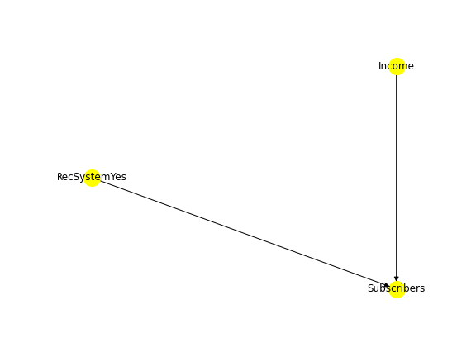
Research Question 4 Linear Regressions and ATE
With low r^2, there may be other factors affecting the subscriber count outside of Income and Recommendation System.
This diagram shows that our covariate ‘Income’ is not impacted by our treatment variable ‘RecSystemYes.’ Annual average income is not influenced by whether or not the region receives the recommendation feature and therefore making it a good control.
Covariate
Conclusion
The recommendation system proves to be a bust as it decreases the number of subscribers
Both regressions produced a very low r^2 which means a high variance around the regression line and we need to explore other factors that can influence a region’s choice in subscribing to Disney+.
[Figure 13: Casual Diagram with Income, RecSystemYes, and Subscribers]
Notes:
Source: World Resource Institute, Global Forest Watch

Slide 11
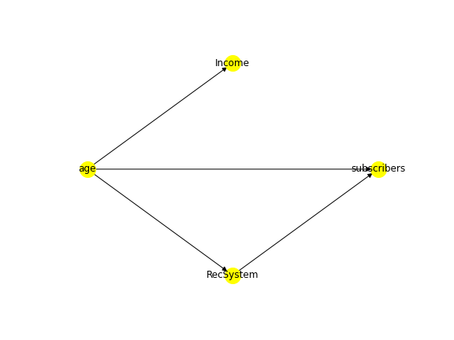
Research Question 5 Do-Why Causal Analysis + Refutations
We can conclude that there is a causal relationship between the recommendation system and the number of subscribers of Disney+.
Casual Effect 2.495 -> It means that if the Disney recommendation system is implemented, it will cause Disney+ subscribers to increase by 2495
P-value of 0.500 > 0.05 significance level
Casual Effect
Backdoor Regression
Placebo treatment: -0.375. It is close to 0. The p-value is 0.39 > 0.05
Using a subset of Data -0.690. It is close to the original estimate of -0.695. The p-value is 0.459 >0.05
Propensity Score Matching
Placebo treatment: -0.274. It is close to 0. The p-value is 0.459 > 0.05
Using a subset of Data 0.736. The p-value is 0.255 >0.05
[Figure 14: Causal relationship with Income, Age, RecSystem, and subscribers]
Notes:
Source: World Resource Institute, Global Forest Watch

Slide 12



Conclusions and Discussion
Disney’s Recommendation in response to each dataset results
Key Takeaways: Focus on producing movies with the top 6 successful genres: Action, Adventure, Musical, Romantic Comedy, Thriller/ Suspense, and Western
Limitations: Unable to narrow it down more
Future Work: 2 factor anova for ratings and genre
Key Takeaways: There exists no preference for villians/heroes between people ages>40 and people agesa <= 40.
Limitations: Data contains only people above 18 and majority of Disney consumers are under 18.
Future Work: Including the having kids factor for analysis as children can often challenge our perceptions.
Key Takeaways: Consider implementing the system to more regions and add more features to retain consumers
Limitations: causal diagram could be incorrect thus allowing for bias in the analysis
Future Work: testing price sensitivity +$1/-$1 with regression for the recommendation system
Notes:
https://www.rainforest-alliance.org/approach/
https://www.rainforest-alliance.org/insights/our-360-approach-to-stopping-rainforest-destruction/

